Slide 1
Hypothesis Test Proportions
Chapter 19

Slide 2
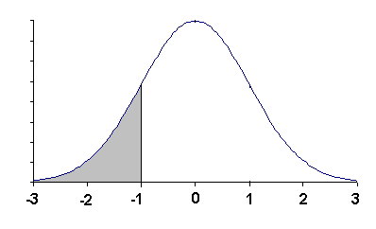
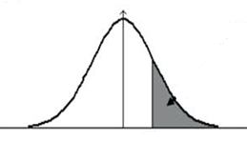
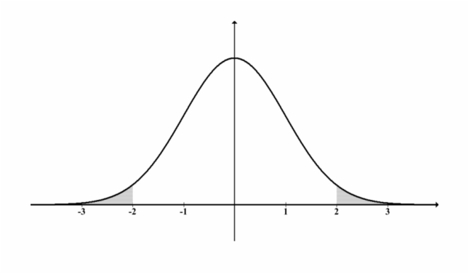
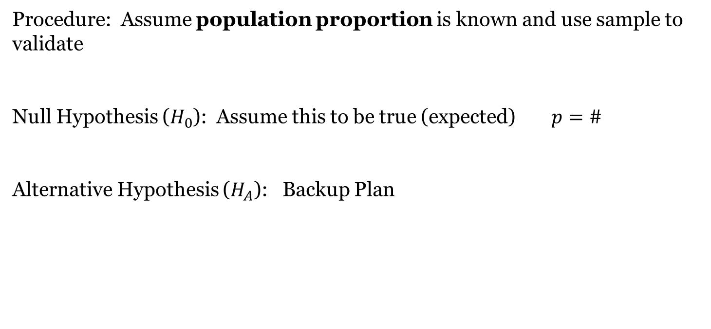
Hypothesis Test
Procedure: Assume population proportion is known and use sample to validate
Null Hypothesis ($H_{0}$): Assume this to be true (expected)$p=\#$
Alternative Hypothesis ($H_{A}$): Backup Plan
$$p<\#$$
$$p>\#$$
$p≠\#$ (2-tailed)

Slide 3
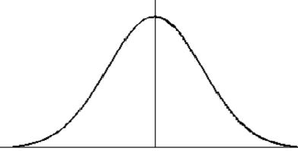
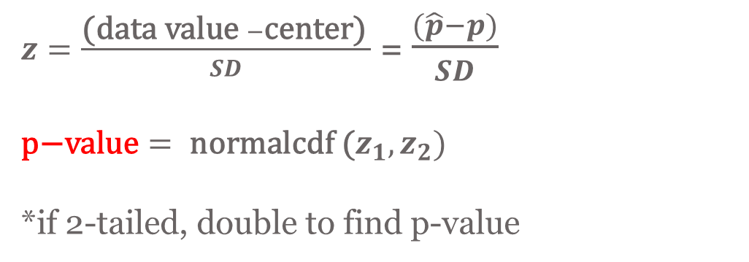
$z=\frac{\text{(}\text{data} \text{value} −\text{center}\text{)} }{SD}$ = $\frac{(\hat{p}−p)}{SD}$ $$\text{p}\text{−}\text{value}= \text{normalcdf}\text{ (}z_{1},z_{2})$$ *if 2-tailed, double to find p-value
Count = SD =$\sqrt{\frac{p(1−p)}{n}}$
Use z-distribution
p
Check:
STAT TESTS #5
(1-Prop z Test)

Slide 4
Conditions/Assumptions
Independence Assumption: The sampled values must be independent of each other.
Randomization Condition: The data values must be sampled randomly.
10% Condition: When the sample is drawn without replacement, the sample size, n, should be no more than 10% of the population.
Sample Size Assumption: The sample size must be sufficiently large.
Success Clause: $np≥10$
Failure Clause: $n\left(1−p\right)≥10$

Slide 5
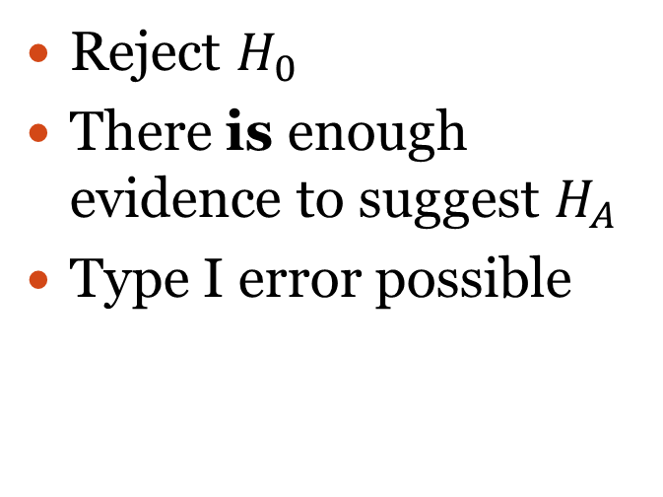
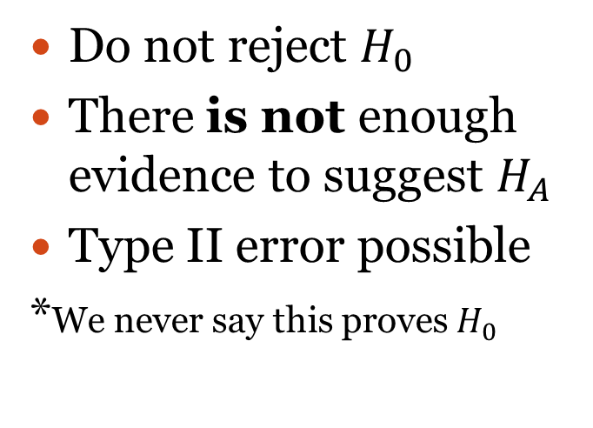
Conclusions
If p-value > alpha level
($\hat{p}$ expected)
If p-value < alpha level
($\hat{p}$ unusual)
Do not reject $H_{0}$
There is not enough evidence to suggest $H_{A}$
Type II error possible
*We never say this proves $H_{0}$
Reject $H_{0}$
There is enough evidence to suggest $H_{A}$
Type I error possible
Alpha level 0.05 unless otherwise stated
p-value: probability of observing $\hat{p}$ when $H_{0}$ is assumed to be true

Slide 6
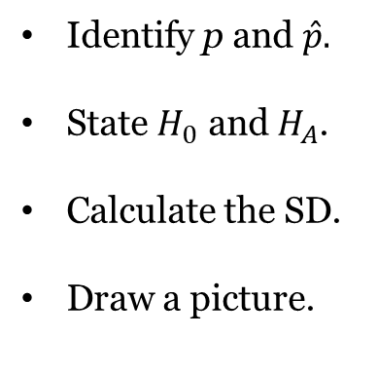
According to the Institute for College Access and Success, 67% of all college
students in a recent year graduated with student loan debt.
University of Central Florida reports that only 52% of its graduates from a
random sample of 500 students have student loan debt.
Use a hypothesis test to determine if there is enough evidence to support
UCF’s claim that student loan debt is less. Assume that all conditions have
been met and proceed with the hypothesis test.
Identify p and $\hat{p}.$
State $H_{0}$ and $H_{A}$.
Calculate the SD.
Draw a picture.
Calculate z.
Calculate p-value.
Make a conclusion.

Slide 7
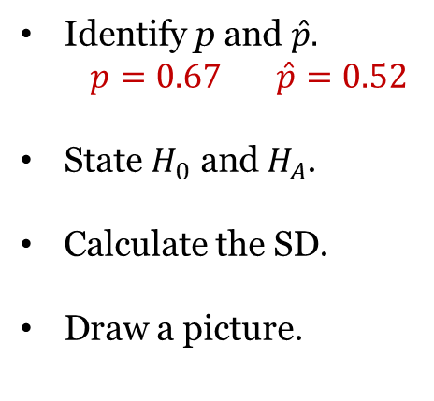
According to the Institute for College Access and Success, 67% of all college
students in a recent year graduated with student loan debt.
University of Central Florida reports that only 52% of its graduates from a
random sample of 500 students have student loan debt.
Use a hypothesis test to determine if there is enough evidence to support
UCF’s claim that student loan debt is less. Assume that all conditions have
been met and proceed with the hypothesis test.
Identify p and $\hat{p}.$
$$p=0.67 \hat{p}=0.52$$
State $H_{0}$ and $H_{A}$.
Calculate the SD.
Draw a picture.
Calculate z.
Calculate p-value.
Make a conclusion.

Slide 8
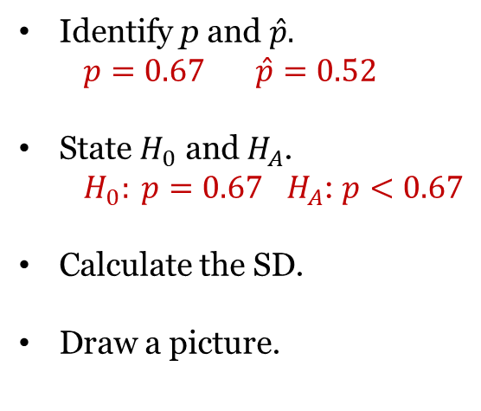
According to the Institute for College Access and Success, 67% of all college
students in a recent year graduated with student loan debt.
University of Central Florida reports that only 52% of its graduates from a
random sample of 500 students have student loan debt.
Use a hypothesis test to determine if there is enough evidence to support
UCF’s claim that student loan debt is less. Assume that all conditions have
been met and proceed with the hypothesis test.
Identify p and $\hat{p}.$
$$p=0.67 \hat{p}=0.52$$
State $H_{0}$ and $H_{A}$.
$H_{0}: p=0.67$ $H_{A}$: $p<0.67$
Calculate the SD.
Draw a picture.
Calculate z.
Calculate p-value.
Make a conclusion.

Slide 9
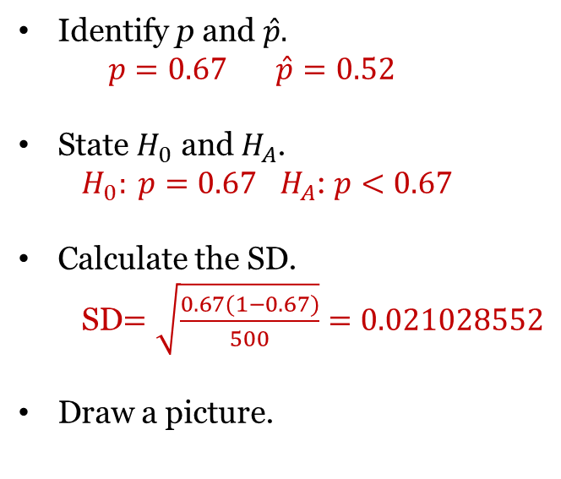
According to the Institute for College Access and Success, 67% of all college
students in a recent year graduated with student loan debt.
University of Central Florida reports that only 52% of its graduates from a
random sample of 500 students have student loan debt.
Use a hypothesis test to determine if there is enough evidence to support
UCF’s claim that student loan debt is less. Assume that all conditions have
been met and proceed with the hypothesis test.
Identify p and $\hat{p}.$
$$p=0.67 \hat{p}=0.52$$
State $H_{0}$ and $H_{A}$.
$H_{0}: p=0.67$ $H_{A}$: $p<0.67$
Calculate the SD.
SD$=\sqrt{\frac{0.67(1−0.67)}{500}}=0.021028552$
Draw a picture.
Calculate z.
Calculate p-value.
Make a conclusion.

Slide 10
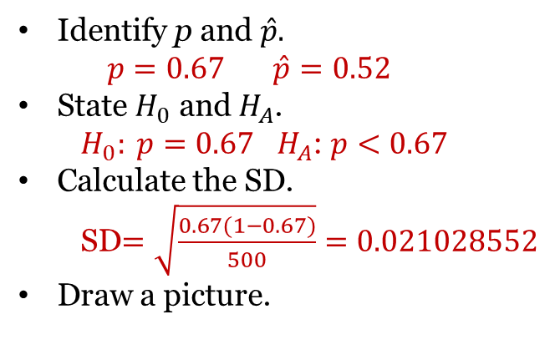
According to the Institute for College Access and Success, 67% of all college
students in a recent year graduated with student loan debt.
University of Central Florida reports that only 52% of its graduates from a
random sample of 500 students have student loan debt.
Use a hypothesis test to determine if there is enough evidence to support
UCF’s claim that student loan debt is less. Assume that all conditions have
been met and proceed with the hypothesis test.
Identify p and $\hat{p}.$
$$p=0.67 \hat{p}=0.52$$
State $H_{0}$ and $H_{A}$.
$H_{0}: p=0.67$ $H_{A}$: $p<0.67$
Calculate the SD.
SD$=\sqrt{\frac{0.67(1−0.67)}{500}}=0.021028552$
Draw a picture.
Calculate z.
Calculate p-value.
Make a conclusion.
0.52
0.61
0.63
0.65
0.69
0.71
0.73
0.67

Slide 11
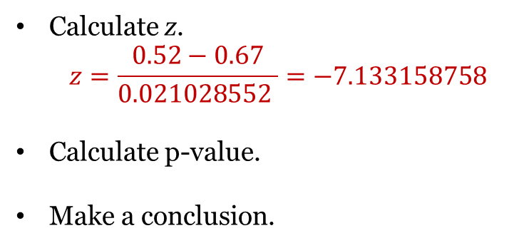
According to the Institute for College Access and Success, 67% of all college
students in a recent year graduated with student loan debt.
University of Central Florida reports that only 52% of its graduates from a
random sample of 500 students have student loan debt.
Use a hypothesis test to determine if there is enough evidence to support
UCF’s claim that student loan debt is less. Assume that all conditions have
been met and proceed with the hypothesis test.
Identify p and $\hat{p}.$
$$p=0.67 \hat{p}=0.52$$
State $H_{0}$ and $H_{A}$.
$H_{0}: p=0.67$ $H_{A}$: $p<0.67$
Calculate the SD.
SD$=\sqrt{\frac{0.67(1−0.67)}{500}}=0.021028552$
Draw a picture.
Calculate z.
$$z=\frac{0.52−0.67}{0.021028552 }=−7.133158758$$
Calculate p-value.
Make a conclusion.
0.52
0.61
0.63
0.65
0.69
0.71
0.73
0.67

Slide 12
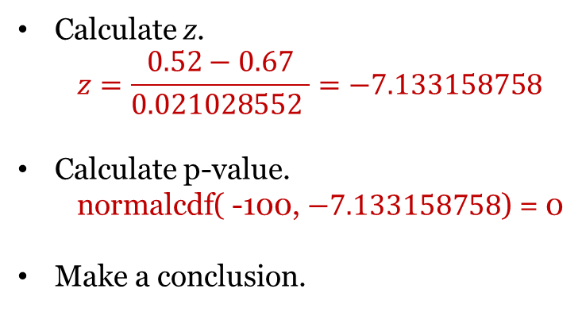
According to the Institute for College Access and Success, 67% of all college
students in a recent year graduated with student loan debt.
University of Central Florida reports that only 52% of its graduates from a
random sample of 500 students have student loan debt.
Use a hypothesis test to determine if there is enough evidence to support
UCF’s claim that student loan debt is less. Assume that all conditions have
been met and proceed with the hypothesis test.
Identify p and $\hat{p}.$
$$p=0.67 \hat{p}=0.52$$
State $H_{0}$ and $H_{A}$.
$H_{0}: p=0.67$ $H_{A}$: $p<0.67$
Calculate the SD.
SD$=\sqrt{\frac{0.67(1−0.67)}{500}}=0.021028552$
Draw a picture.
Calculate z.
$$z=\frac{0.52−0.67}{0.021028552 }=−7.133158758$$
Calculate p-value.
normalcdf( -100, $−7.133158758$) = 0
Make a conclusion.
0.52
0.61
0.63
0.65
0.69
0.71
0.73
0.67

Slide 13
According to the Institute for College Access and Success, 67% of all college
students in a recent year graduated with student loan debt.
University of Central Florida reports that only 52% of its graduates from a
random sample of 500 students have student loan debt.
Use a hypothesis test to determine if there is enough evidence to support
UCF’s claim that student loan debt is less. Assume that all conditions have
been met and proceed with the hypothesis test.
Identify p and $\hat{p}.$
$$p=0.67 \hat{p}=0.52$$
State $H_{0}$ and $H_{A}$.
$H_{0}: p=0.67$ $H_{A}$: $p<0.67$
Calculate the SD.
SD$=\sqrt{\frac{0.67(1−0.67)}{500}}=0.021028552$
Draw a picture.
Calculate z.
$$z=\frac{0.52−0.67}{0.021028552 }=−7.133158758$$
Calculate p-value.
normalcdf( -100, $−7.133158758$) = 0
Make a conclusion.
Reject $H_{0}.$ There is enough evidence to
Suggest UCF’s claim that student loan
debt is less.
0.52
0.61
0.63
0.65
0.69
0.71
0.73
0.67

Slide 14
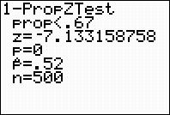
According to the Institute for College Access and Success, 67% of all college
students in a recent year graduated with student loan debt.
University of Central Florida reports that only 52% of its graduates from a
random sample of 500 students have student loan debt.
Use a hypothesis test to determine if there is enough evidence to support
UCF’s claim that student loan debt is less. Assume that all conditions have
been met and proceed with the hypothesis test.
Identify p and $\hat{p}.$
$$p=0.67 \hat{p}=0.52$$
State $H_{0}$ and $H_{A}$.
$H_{0}: p=0.67$ $H_{A}$: $p<0.67$
Calculate the SD.
SD$=\sqrt{\frac{0.67(1−0.67)}{500}}=0.021028552$
Draw a picture.
Calculate z.
$$z=\frac{0.52−0.67}{0.021028552 }=−7.133158758$$
Calculate p-value.
normalcdf( -100, $−7.133158758$) = 0
Make a conclusion.
Reject $H_{0}.$ There is enough evidence to
Suggest UCF’s claim that student loan
debt is less.
Let’s check: STAT TESTS #5
0.52
0.61
0.63
0.65
0.69
0.71
0.73
0.67

Slide 15
According to CNN, 10% of all people are left-handed. You choose a random sample of 500 adults and find that 60 of them are left-handed.
Use a hypothesis test to determine if there is enough evidence to support that left-handedness is higher than what CNN reports.
Use a 95% confidence interval to determine if there is enough evidence to support that left-handedness is higher than what CNN reports.

Slide 16
According to CNN, 10% of all people are left-handed. You choose a random sample of 500 adults and find that 60 of them are left-handed.
Use a hypothesis test to determine if there is enough evidence to support that left-handedness is higher than what CNN reports.
$H_{0}: p=0.10$ $H_{A}$: $p>0.10$ $\hat{p}=0.12$ SD$=\sqrt{\frac{0.10(1−0.10)}{500}}=0.0134164079$
$z=\frac{0.12−0.10}{0.021028552 }=$1.490711985 normalcdf(1.490711985, 100 ) = 0.0680185941
Do not reject $H_{0}$. There is not enough evidence to suggest left-handedness is higher than what CNN reports.
Use a 95% confidence interval to determine if there is enough evidence to support that left-handedness is higher than what CNN reports.
SD$=\sqrt{\frac{0.12(1−0.12)}{500}}=0.0145327217$ $z=$ invnorm(0.025)=-1.959963986
CI=$±z∗SD+center$ (0.09152, 0.14848)
Although 10% is in the interval, the entire interval is not above 10%. Thus, there is not enough evidence to suggest left-handedness is higher than what CNN reports.
Remember the center is $p=0.10$
Remember the center is $\hat{p}=0.12$

